Slide 1
Introduction to Compiler Construction

Slide 2
Compilers and Interpreters
“Compilation”
  Translation of a program written in a source language into a semantically equivalent program written in a target language
Input
Source
Program
Compiler
Target
Program
Error messages
Output

Slide 3
Compilers and Interpreters…
“Interpretation”
  Performing the operations implied by the source program
Source
Program
Interpreter
Output
Input
Error messages

Slide 4
Preprocessors, Compilers, Assemblers, and Linkers
Skeletal Source Program
Preprocessor
Source Program
Compiler
Target Assembly Program
Assembler
Relocatable Object Code
Linker
Libraries and
Relocatable Object Files
Absolute Machine Code

Slide 5
The Phases of a Compiler
Phase | Output | Sample
Programmer (source code producer) | Source string | A=B+C;
Scanner (performs lexical analysis) | Token string | ‘A’, ‘=’, ‘B’, ‘+’, ‘C’, ‘;’ And symbol table with names
Parser (performs syntax analysis based on the grammar of the programming language) | Parse tree or abstract syntax tree | ; | = / \ A + / \ B C
Semantic analyzer (type checking, etc) | Annotated parse tree or abstract syntax tree
Intermediate code generator | Three-address code, quads, or RTL | int2fp B t1 + t1 C t2 := t2 A
Optimizer | Three-address code, quads, or RTL | int2fp B t1 + t1 #2.3 A
Code generator | Assembly code | MOVF #2.3,r1 ADDF2 r1,r2 MOVF r2,A
Peephole optimizer | Assembly code | ADDF2 #2.3,r2 MOVF r2,A

Slide 6
Classifications of Compilers
Depending on the working of Compilers are classified as:
  Single Pass
  Multi Pass
  Load-and-Go
  Debugging
  Optimizing

Slide 7
Cousins of Compiler
Preprocessors
  Macro Processing
  File Inclusion
  Rational Preprocessors (support older languages with more Modern Flow-of-Control and Data Structuring facilities)
  Language Extensions
Assemblers
  Produced Assembly Code is passed to the Assemblers for further Processing
  Some compiler produced the Relocatable Machine Codes that can be passed directly to the Loader/Link-Editors.
Two-Pass Compiler
Loader and Link-Editors

Slide 8
Compilers may be distinguished according to the kind of target code they generate:
  Pure Machine Code
    Assume there is no run-time OS support.
    For systems implementation or embedded systems
    Run on bare machines
  Augmented Machine Code
    For hardware + OS + language-specific support routines, e.g., I/O, math functions, storage allocation, and data transfer.
  Virtual Machine Code
    JVM, P-code
    Portable
    Code is interpreted.

Slide 9
Another kind of language processor, called an Interpreter, differs from a Compiler in that it executes programs without explicitly performing a translation
Interpreter
Output
Source
Program
Encoding
Data

Slide 10
Advantages and Disadvantages of an Interpreter
Advantages
  Modification to program during execution
    Interactive debugging
    Not for every language, e.g., Basic, Pascal
  Dynamic-typed languages
    Variable types may change at run time, e.g., LISP.
    Difficult to compile
  Better diagnostics
    Source code is available.
  Machine independence
    However, the interpreter itself must be portable.

Slide 11
Disadvantage
  Slower execution due to repeated examination
  Substantial space overhead

Slide 12
The Structure of a Compiler
Source
Program
Scanner
Tokens
Parser
Syntactic
Semantic
Routines
(Character
Stream)
Structure
Intermediate
Representation
Symbol and
Attribute
Tables
Optimizer
(Used by all Phases
of The Compiler)
Code
Generator
Target Machine
Code

Slide 13
The Structure of a Compiler
Any compiler must perform two major tasks
  Analysis of the source program
    This part breaks up the source program into Constituent Pieces.
    Creates an Intermediate Representation (IR) of the source program
  Synthesis of a machine-language program
    This Part construct the desired target Program from the IR

Slide 14
Analysis Phase of Compiler
Analysis consists of Three Phases
  Linear Analysis
    Read the Source Program from Left to Right and Grouped into Tokens that are sequences of Characters having collective meaning.
    Also called Lexical Analysis or Scanning, e.g, Position=Initial+Rate*60
    This would be grouped into Tokens

Slide 15
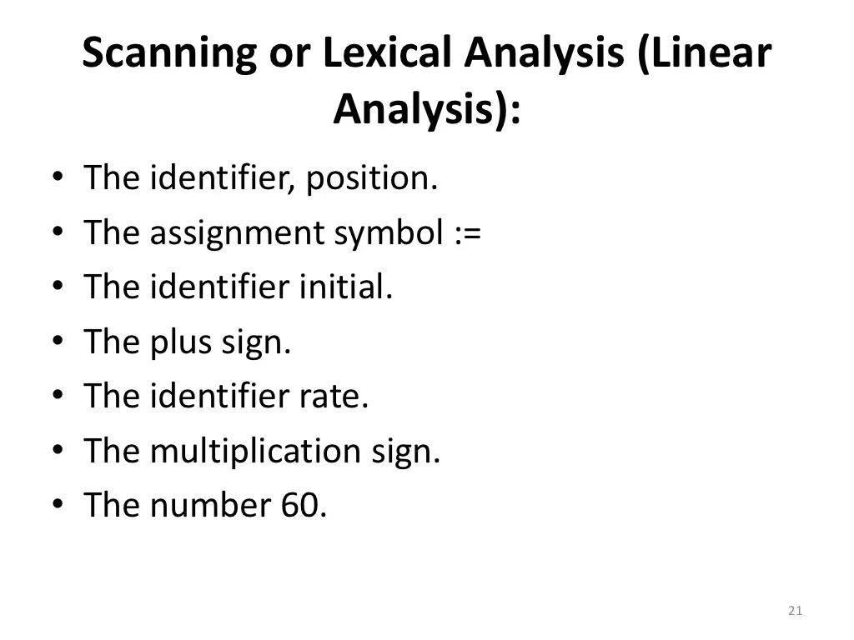

Slide 16
Analysis Phase of Compiler
Hierarchical Analysis
  The characters or Tokens are grouped hierarchically into nested collections with collective meaning.
  Also called Parsing or Syntax Analysis.
  The grammatical phrases of the source program are represented by a Parse Tree.
  It involves grouping the tokens of the source program into grammatical phases that are used by the compiler to Synthesize output.
  The hierarchical structure of a program is usually expressed by recursive rules, e.g, we might have the following rules, as part of the definition of the expression.

Slide 17
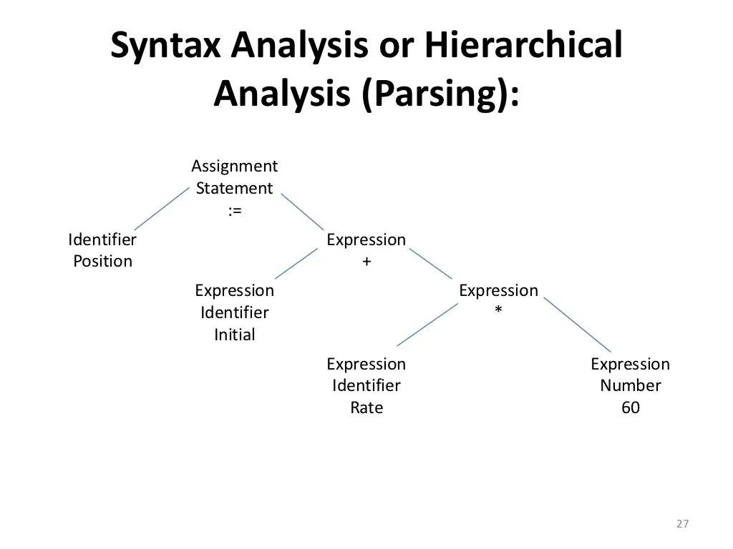

Slide 18
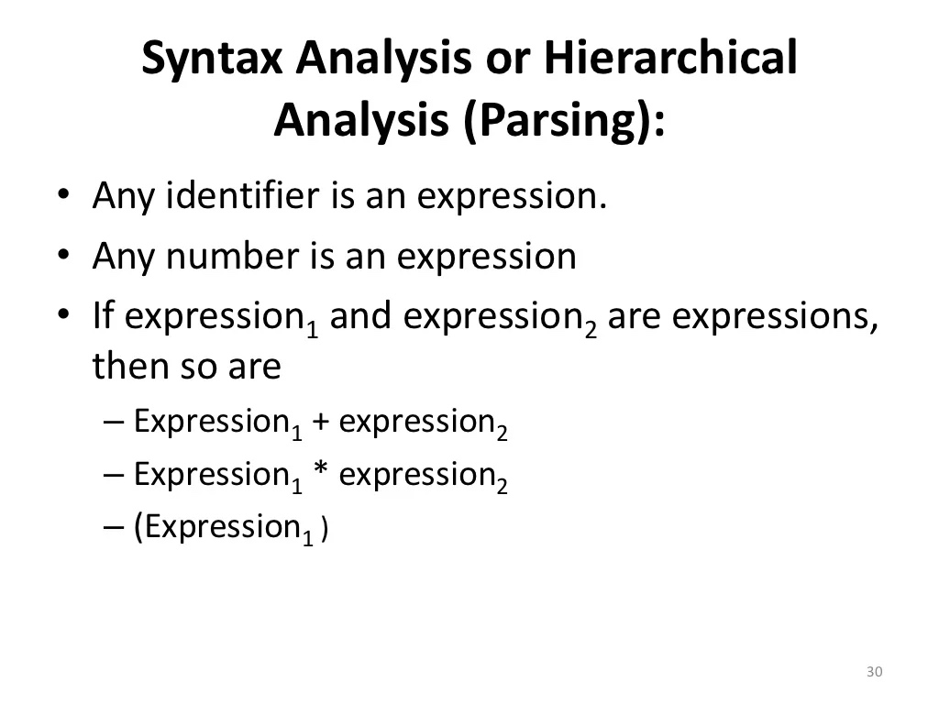

Slide 19
Analysis Phase of Compiler
Semantic Analysis
  In this certain checks are performed to ensure that the components of a program fit together meaningfully.
  The semantic analysis phase checks the source program for semantic errors and gathers type information for the subsequent code-generation phase.
  The compiler checks that each operator has operands that are permitted by the source language specification, e.g., when a Binary Arithmetic Operator is applied to an integer and Real. In this case Compiler needs to convert Integer to Real.

Slide 20
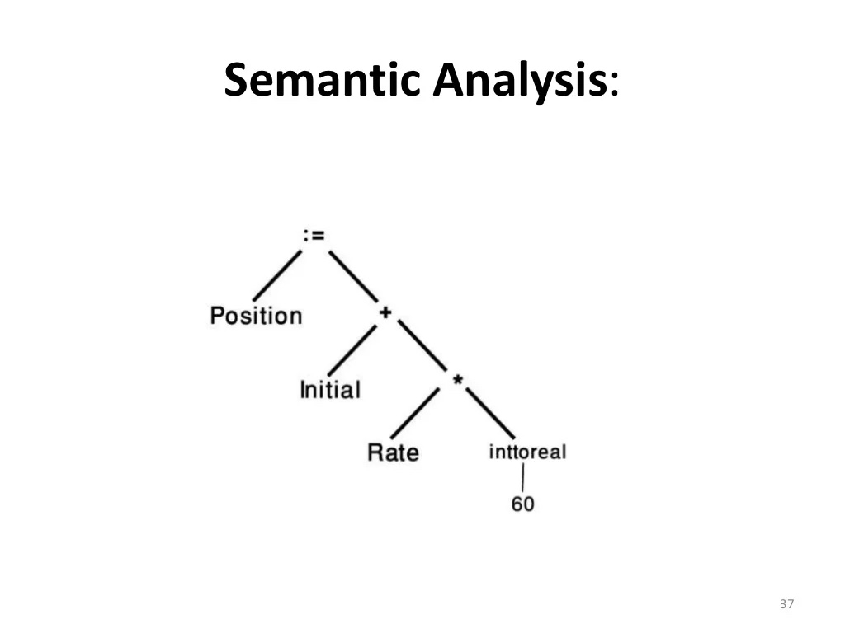

Slide 21
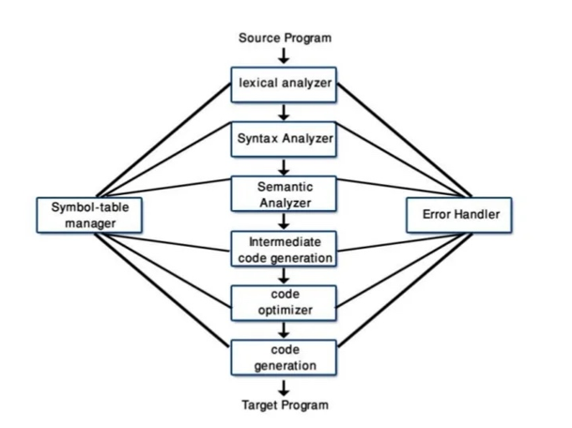

Slide 22
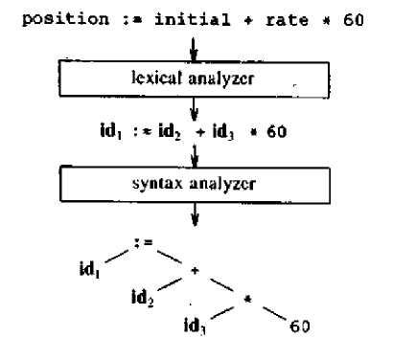
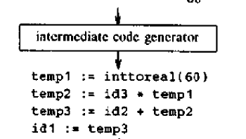
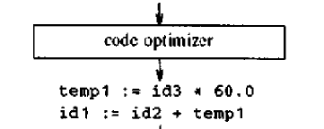
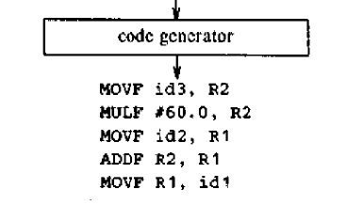
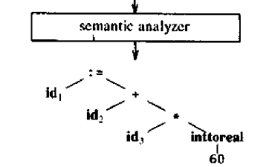
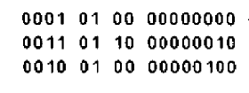

Slide 23
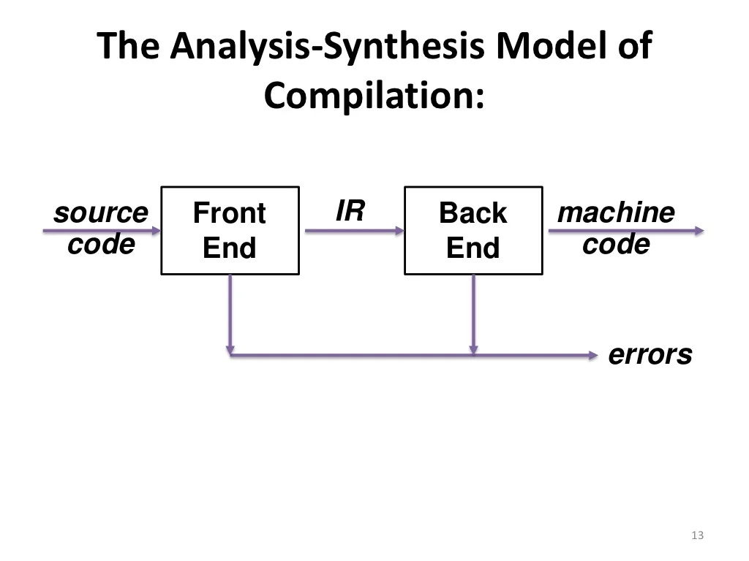

Slide 24
The Grouping of Phases of Compiler
Compiler front and back ends:
  Front End: Analysis (Machine Independent) The front end consists of those phases that depends primarily on the source language and are largely independent of the target Machine.
  Normally, Lexical and Syntactic Analysis, Symbol table, Semantic Analysis and Intermediate Code. Some code optimization can also be done by front end.
  Back End: Synthesis (Machine Dependent) Includes the portion of the compiler that depends on the target Machine.
  These portion do not depend on the source language, depends on just the intermediate language.
  Code optimization, Code Generation along with Error Handling and symbol Table Operation.
Compiler passes:
  A collection of phases is done only once (single pass) or multiple times (multi pass)
    Single Pass: usually requires everything to be defined before being used in source program
    Multi Pass: compiler may have to keep entire program representation in memory

Slide 25
Compiler-Construction Tools
Software development tools are available to implement one or more compiler phases
  Scanner generators generates lexical analyzers based on Regular expressions.
  Parser generators
  Syntax-directed translation engines Produce collections of routines that walk the parse tree, generating intermediate code.
  Automatic code generators Translate each operation of IR into Machine language of target machine.
  Data-flow engines help in the gathering the information how values are transmitted from One part of a program to each other part.

